Slide 1
Food and Beverage Management
The sixth edition
Introduction to the Sixth Edition

Slide 2
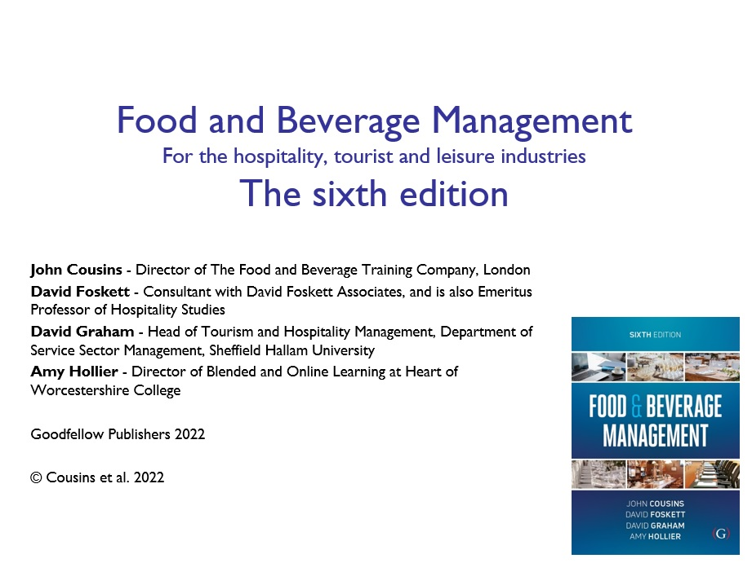

Slide 3
Principal aims of the book are to:
Provide supporting information for those involved, or likely to be involved, at a variety of levels, in food and beverage management
Meet the needs of students and practitioners who are seeking to enhance their competence in the industry
Meet the needs of students studying for a range of qualifications, including City and Guilds, BTEC, Institute of Hospitality, and foundation, undergraduate and postgraduate degrees
Provide support for in-company training programmes, and
Provide a foundation on which to build further knowledge and skills

Slide 4
Structure - based on adaptation of the food service cycle
Chapter 1 Food and beverage operations
Chapter 2 Concept development
Chapter 3 Product development
Chapter 4 Operational areas, equipment and staffing
Chapter 5 Food production
Chapter 6 Beverage provision
Chapter 7 Food and beverage service
Chapter 8 Events, conferencing and banqueting
Chapter 9 Performance appraisal
Chapter 10 Strategic decision making

Slide 5
Learning support
Each chapter has:
  An aim and objectives to indicate the learning that may be achieved
  Example learning activities
  References and additional reading
There are three appendices:
  Appendix A - listing and explanation of performance measures
  Appendix B - an example operational calculations
  Appendix C - example exercise on trading results comparison and evaluation.
PowerPoint presentations for each chapter are available from the publisher’s website

Slide 6
Content
Various approaches to food and beverage management are highlighted
Content reflects current industrial practices
Not intended to be a prescriptive book
The book will also be of value to those in the hospitality, tourism and events industries who are responsible for purchasing food and beverage services

Slide 7
Key influences on the revised content
Increasingly diversified, knowledgeable and value conscious customers
Common causes such as environmental concerns, sustainability, humanitarianism and animal welfare
Enhanced business ethics
Re-establishing the future of food and beverage operations in the wake of the COVID pandemic.
Potential skill shortages and drives for efficiency
Quality of the service, and perceived value, being the main differentiators between operations

Slide 8
Focus
The focus of the material is the management of food and beverage operations
Business management areas such as marketing, human resources and finance are already supported by a wide range of well-established resources
Although some applications of these areas are covered within the book, references are given to other information sources and further reading

Slide 9
Note on PowerPoint presentations
Provided as companion learning support for tutors and trainers who are using the book
Designed to provide a base for tutors to edit to fit their teaching and leaning programme
The presentations are copyright and may only be used or adapted as long as the source is properly acknowledged
No permission has ever been given for the presentations to be published anywhere else, or to be posted online

